Slide 1
CS105 Final Project:
Yellow Cab Trip Records
Members:
Samuel Ha, Jonathan Kim, Sathya Rajesh, Ian Oh

Slide 2
Dataset Used
TLC Trip Record Data
Includes records for yellow and green taxi rides in NYC (pick-up and drop-off dates/times, pick-up and drop-off locations, trip distances, itemized fares, rate types, payment types, and driver-reported passenger counts).
Yellow taxi records for January 2018 used for analysis.

Slide 3
Data Cleaning
The original parquet file that we converted to a csv was ridiculously large(900 MB with 8.6 million rows)
We needed to reduce the file significantly
We removed some redundant/irrelevant columns from the csv
A bunch of random fees, as well as many ID’s that were not relevant to our project
We still needed to preserve useful data/ make processing easier
We added 2 columns, trip duration, and time of day
Adding these columns would make future graphs easier to make, and made it easier to process
There was additional work that needed to be done
Outliers for trip distance and cost were removed
The data had to be separated into two parts, the part for day, and the part for night

Slide 4
Our Goal
Using the various different features provided in the dataset, we are going to form a model that predicts whether a trip occurred during the day or night by using classification models.

Slide 5
Exploratory Data Analysis
Heat Map
Scatter Plot
Bar Chart
Notes:
To make our predictions, we perform some tests on the dataset and find patterns in the data.

Slide 6
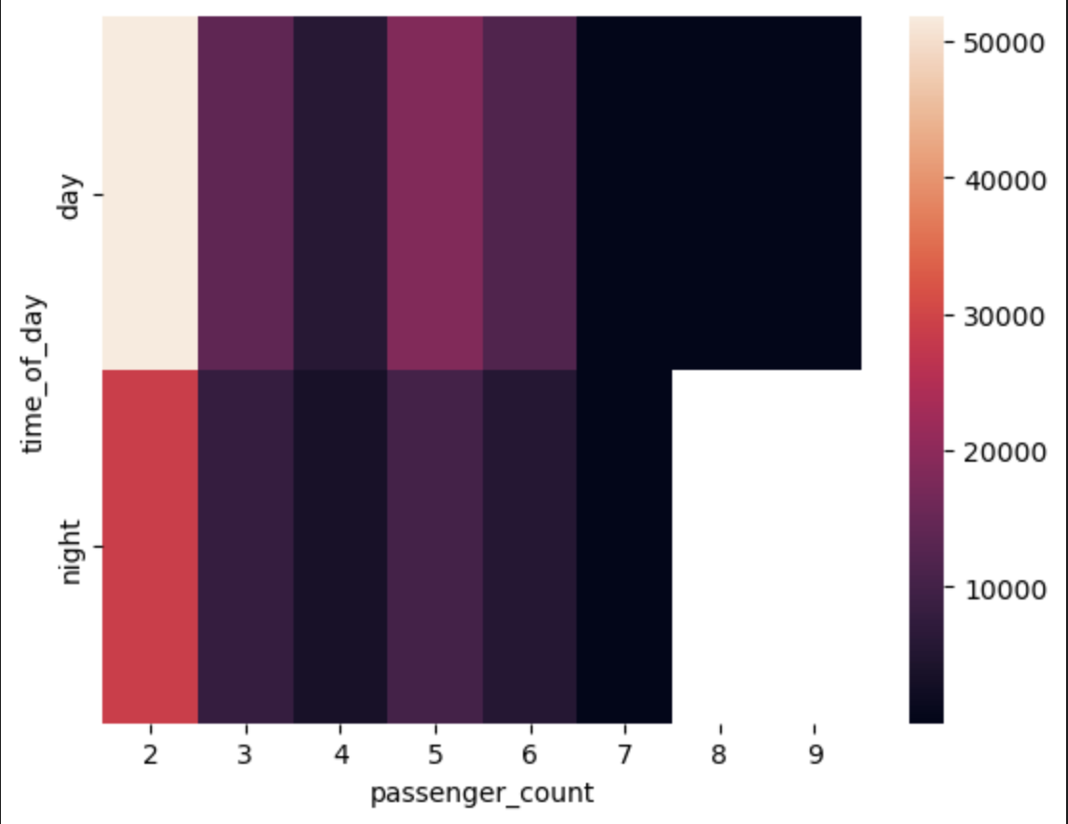
Time of day vs Passenger Count

Slide 7
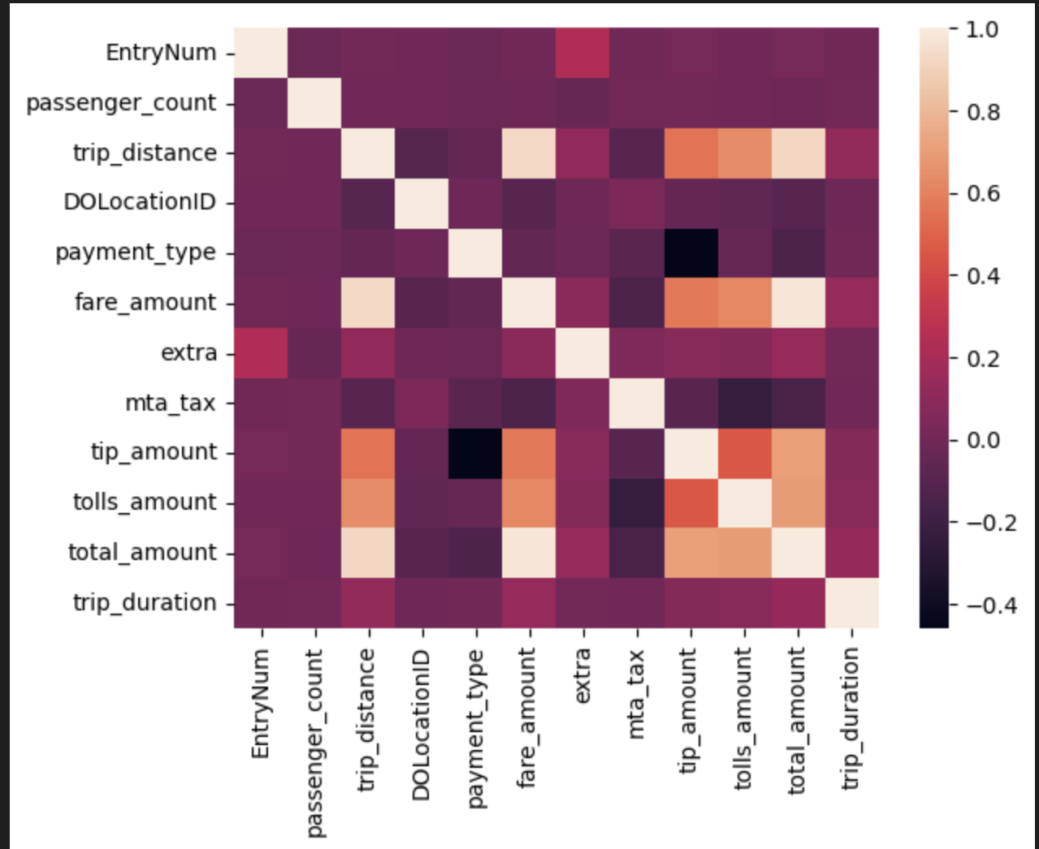
Correlation of Features

Slide 8
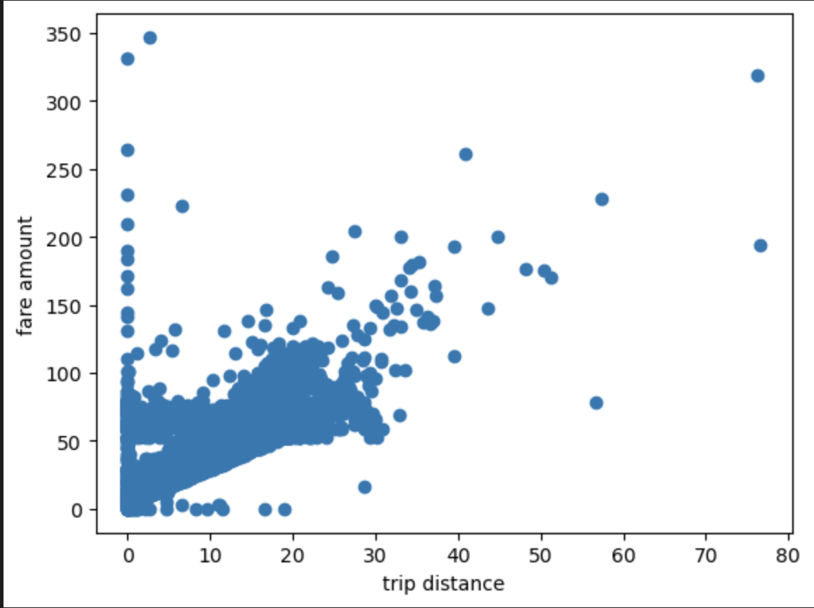
Trip Distance vs Fare Amount

Slide 9
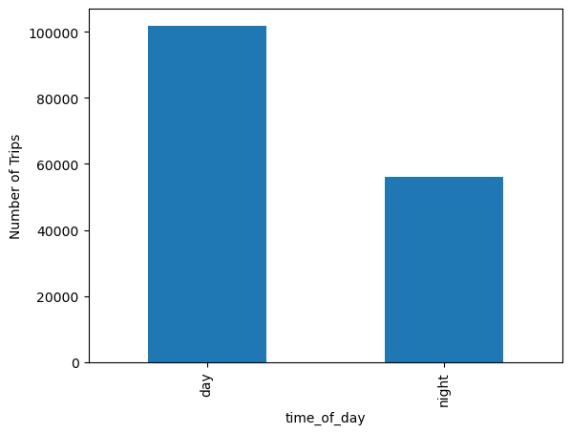
Time of Day vs Numbers of Trips

Slide 10
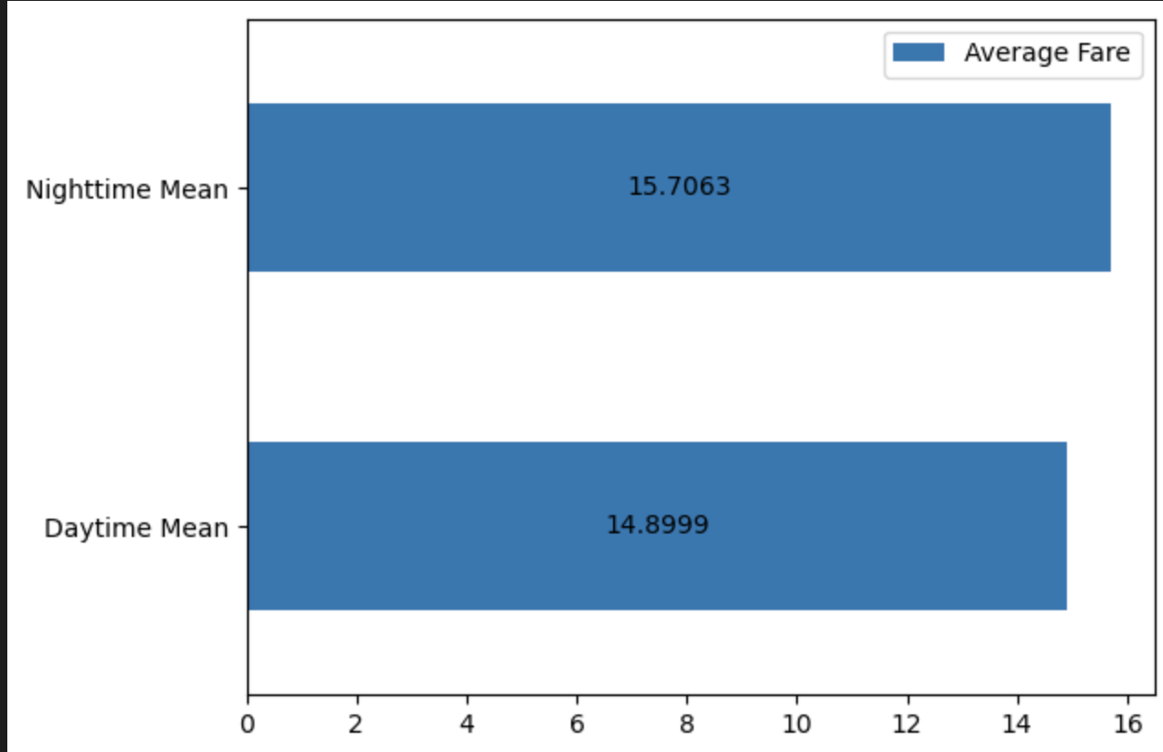
Average Fare

Slide 11
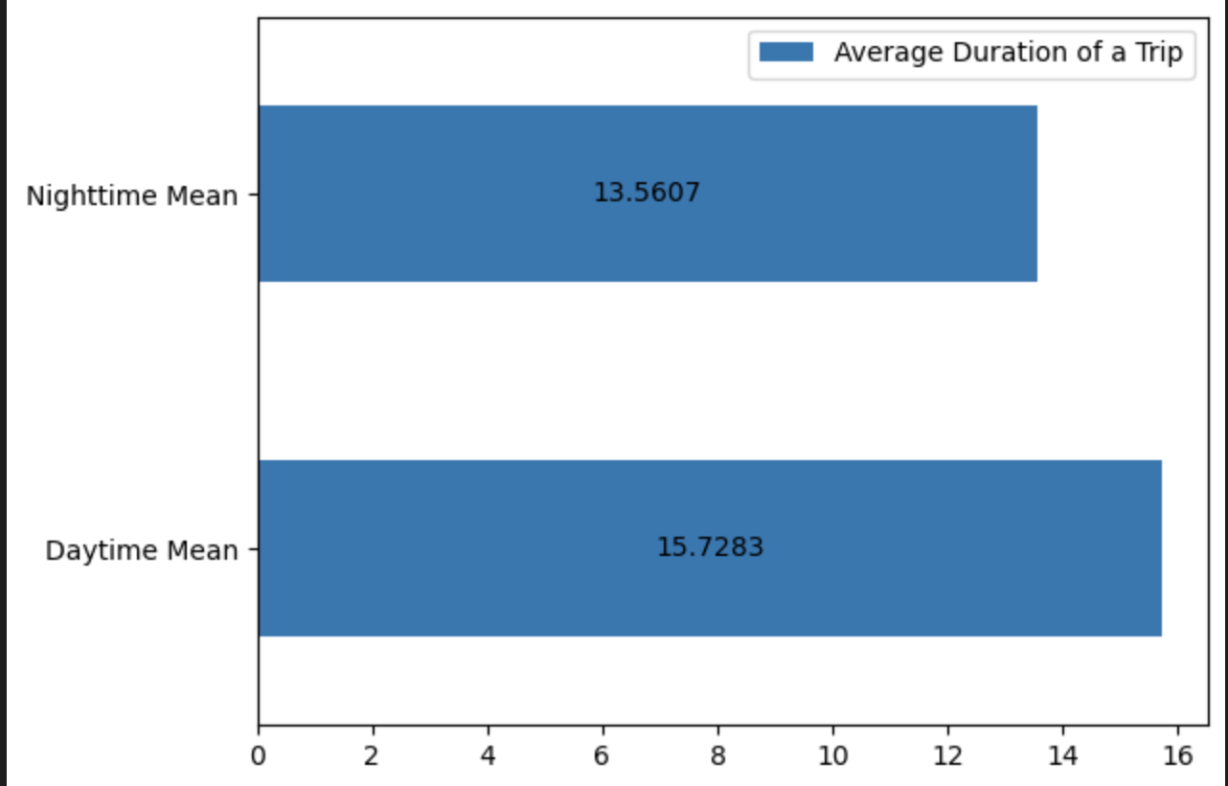
Average Duration

Slide 12
Classification Results
Resulting Accuracies from Classification Models:
KNN: 74%
Decision Tree: 67%
Features Utilized from Dataset:
passenger_count
trip_distance
total_amount
trip_duration

Slide 13
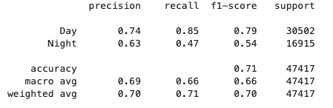
KNN Classification
k = 750
Accuracy = 71%

Slide 14
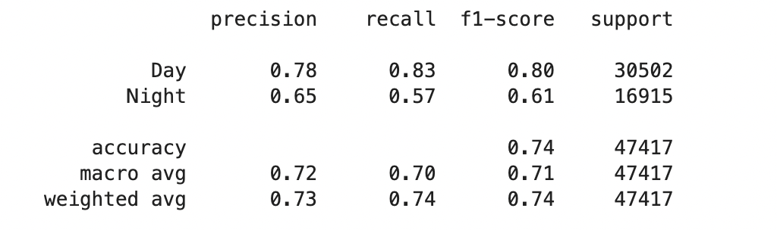
KNN Classification
k = 22
Accuracy = 74%

Slide 15
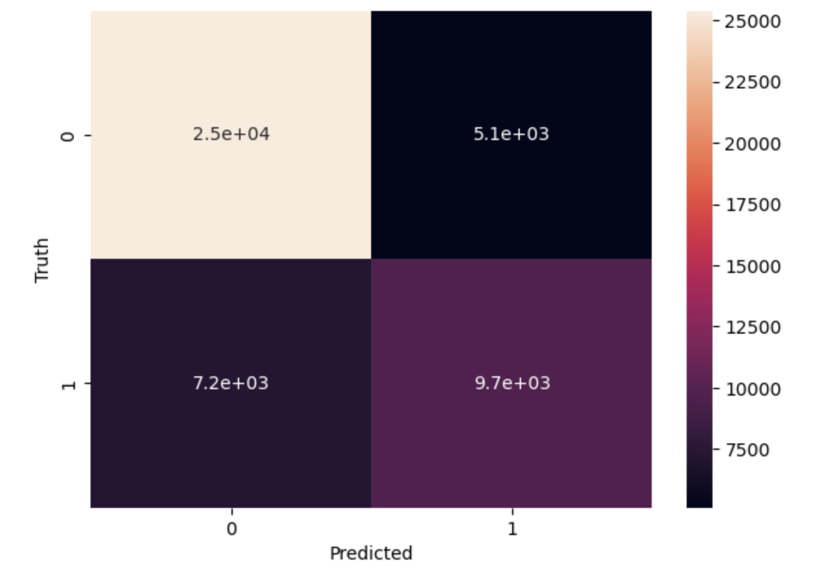
KNN Classification (Continued)
Confusion Matrix Heatmap
1 = Day
0 = Night

Slide 16
Conclusion / Results

Slide 17
Questions
What month was chosen for the dataset?
We ran KNN with both k = 750 and k = 22. Which proved to provide a more accurate result?
What four features were utilized for our classification models?

